Slide 1
Prudential Insurance Risk prediction
Ml foundation Term Project
By: Raj gupta (Aug cohort batch)

Slide 2
Problem statement
The goal is to develop a predictive model that accurately classifies risk using a more automated approach, which can greatly impact public perception of the insurance industry.
The results will help Prudential better understand the predictive power of the data points in the existing assessment, enabling them to significantly streamline the process.
We need to evaluate different ML algorithms and decide the best model for predicting the same.

Slide 3
Data collection
For this problem, dataset is provided by INSAID
In this dataset, we are provided over a hundred variables describing attributes of life insurance applicants
The task is to predict the "Response" variable for each Id in the test set. "Response" is an ordinal measure of risk that has 8 levels.

Slide 4
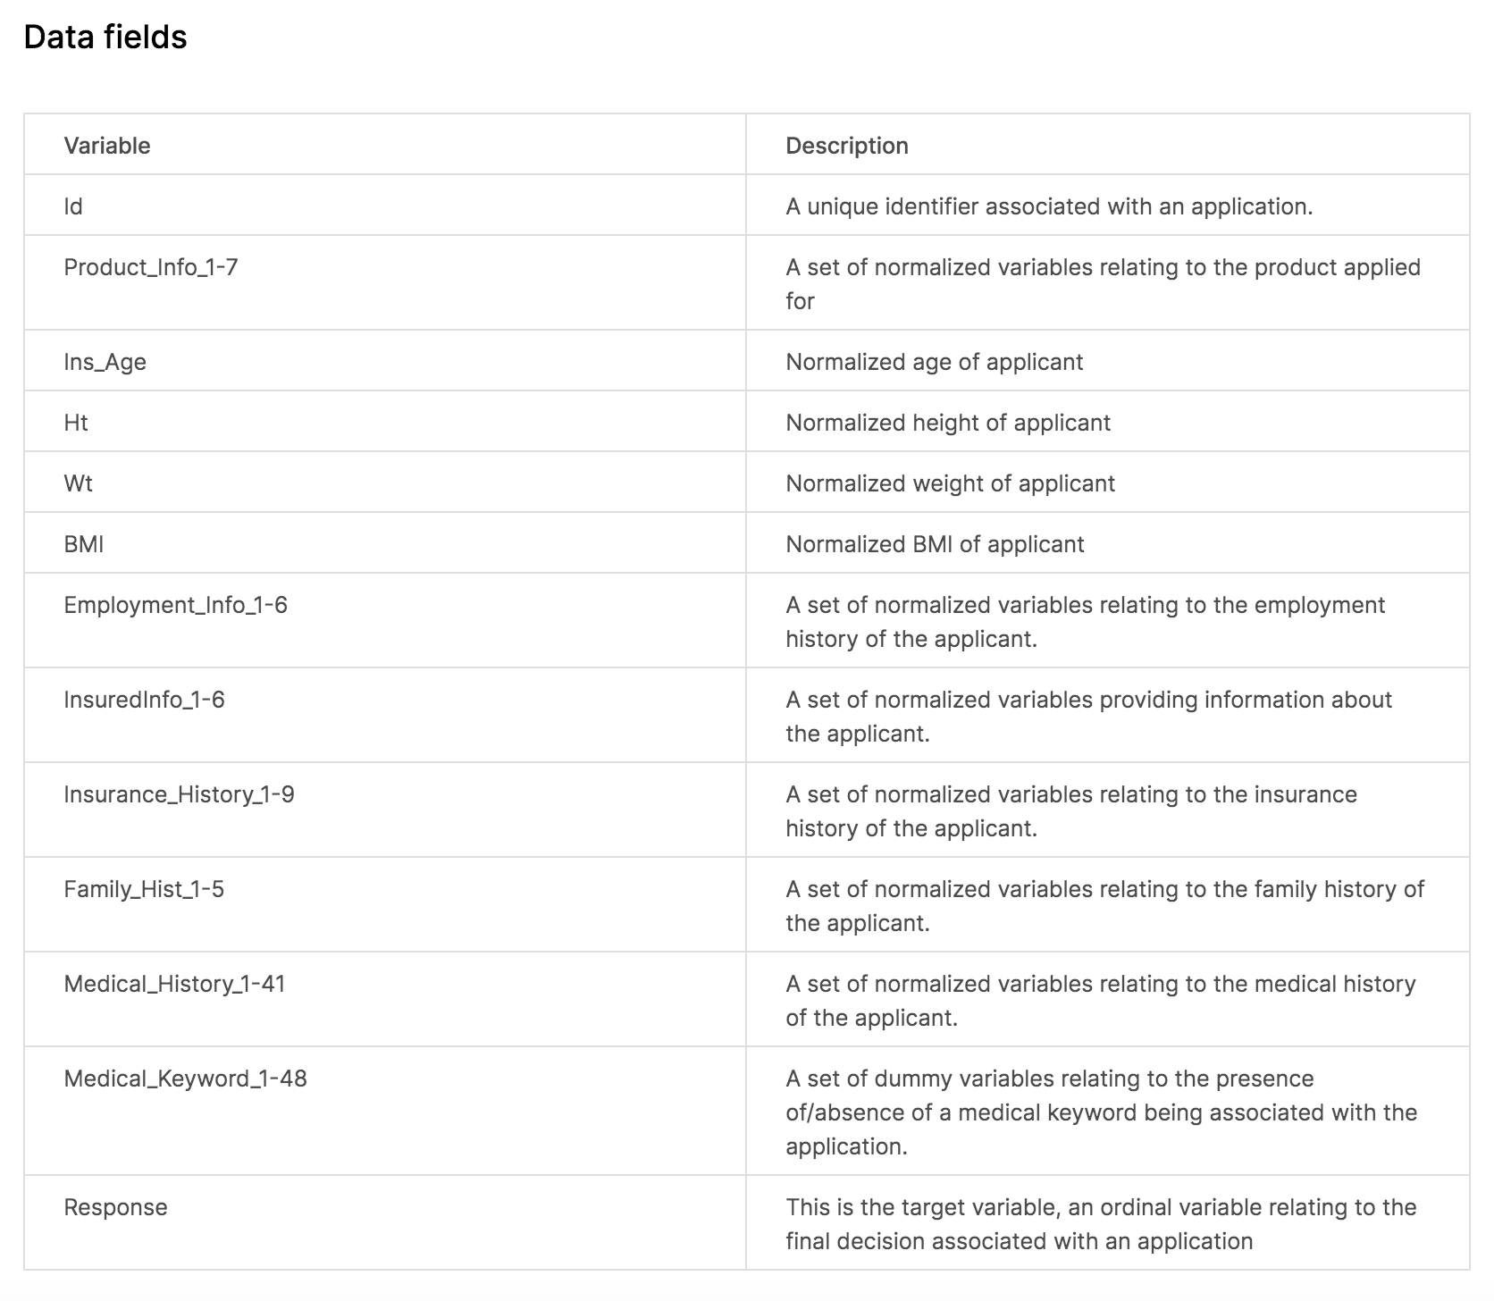
Data description

Slide 5
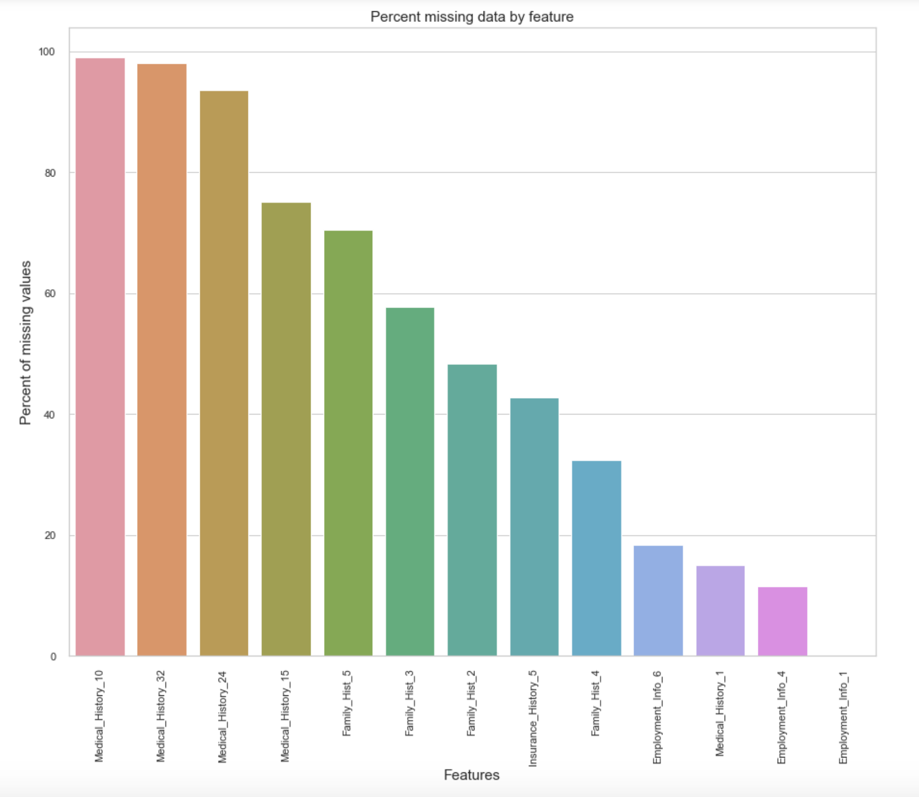
missing data imputation

Slide 6
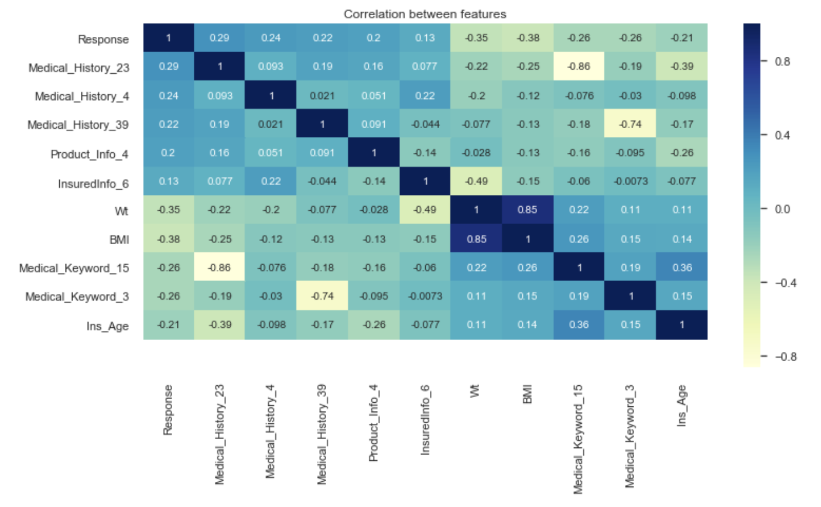
Correlation using heatmap

Slide 7
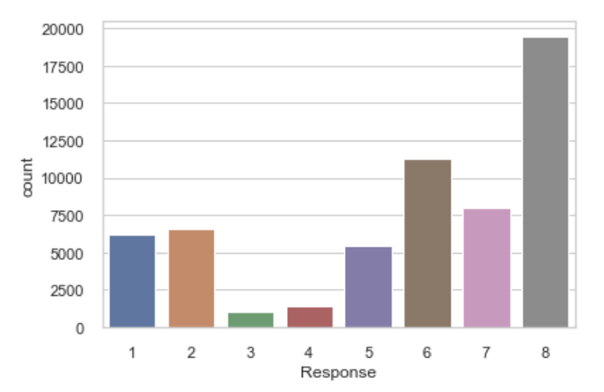
target variable - “Response”
The Response column data had more values closing to Level 8 indicating majority of the applicants fall in this category.

Slide 8
EDA
Response value was higher for lower insured age and it decreased with age. This indicates that the people with lower age were preferred compared to old people.
Insured Age seems to be tending to a normal distribution with insurance age between 20 – 60 being max.
Also, people with less (not low) weight have higher response level. Same goes for BMI.
This gives us an indication that they prefer healthy people to provide the insurance.

Slide 9
model building
Since target variable is a Categorical variable with 8 classes, it is a multi class classification problem.
ML algorithms used for model building are:
Logistic Regression
Decision Tree
Random Forest

Slide 10
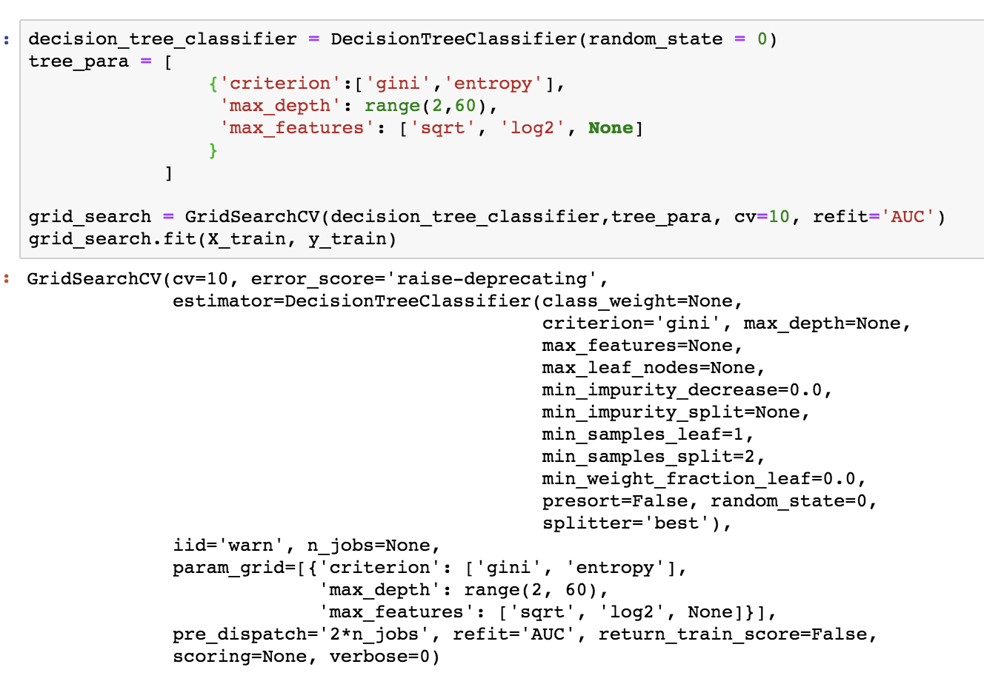
Decision Tree Classifier

Slide 11
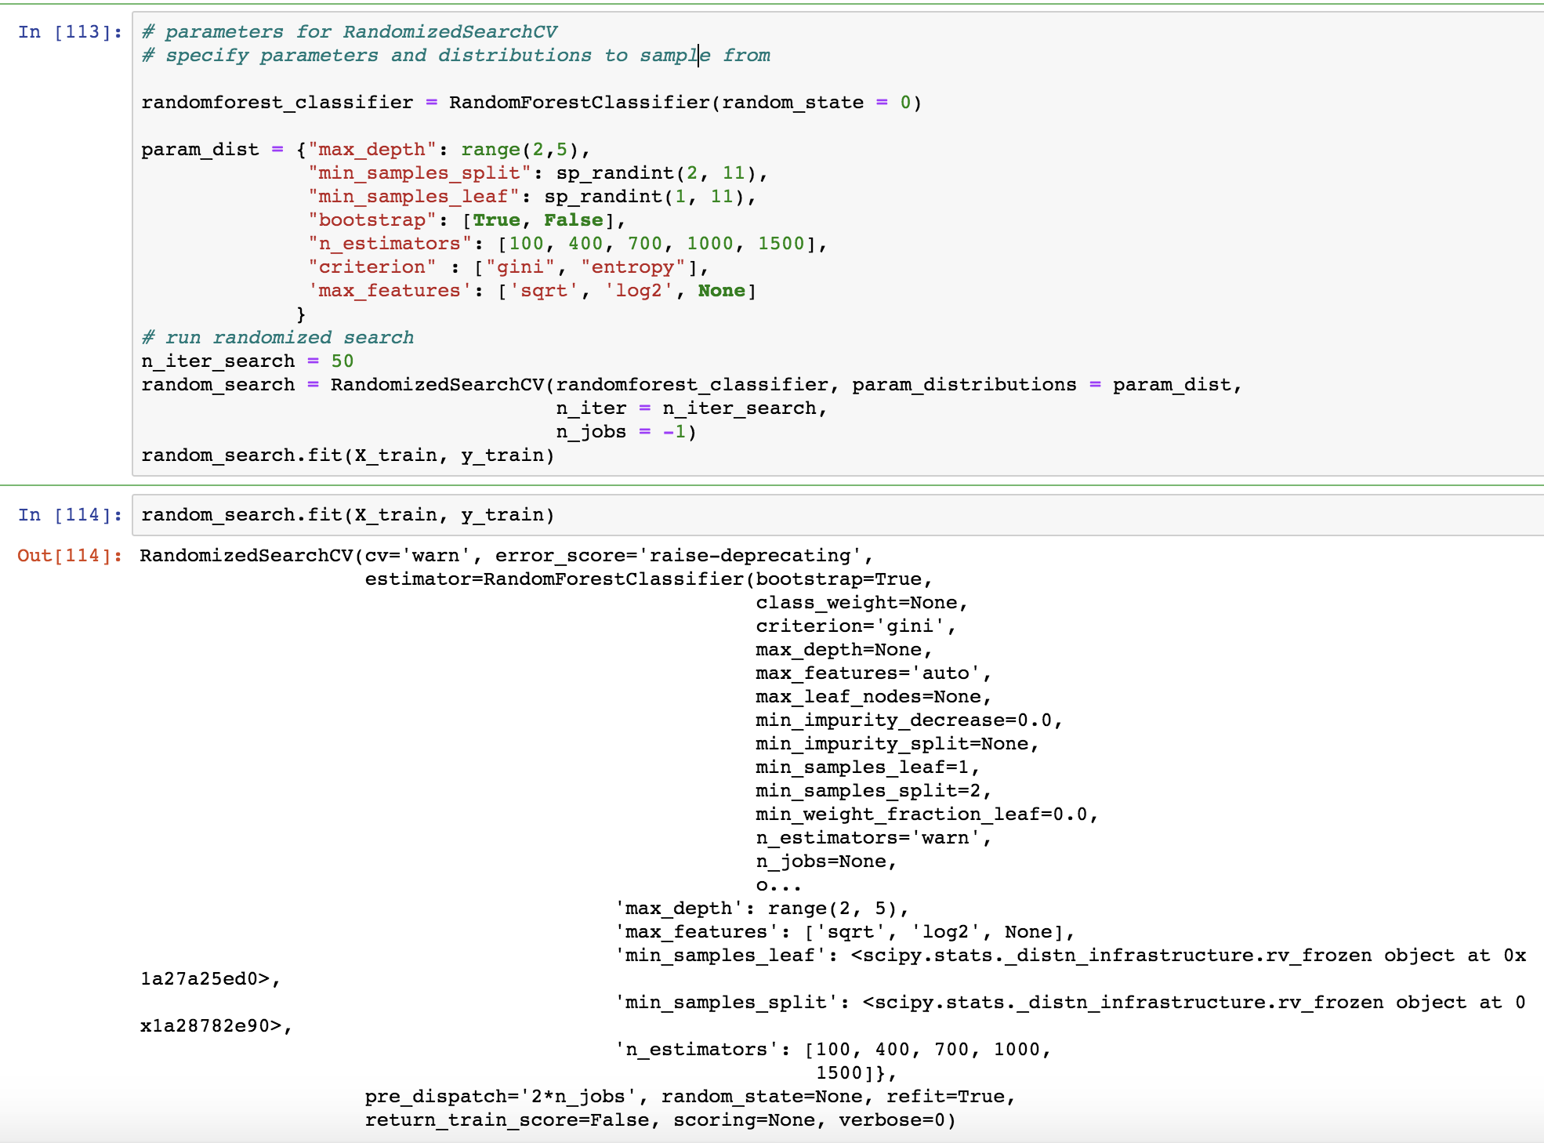
Random Forest Classifier

Slide 12
Model evaluation
For a classification problem, we will evaluate the models based on:
Confusion Matrix
Accuracy Score
Precision
Recall
F1 score

Slide 13
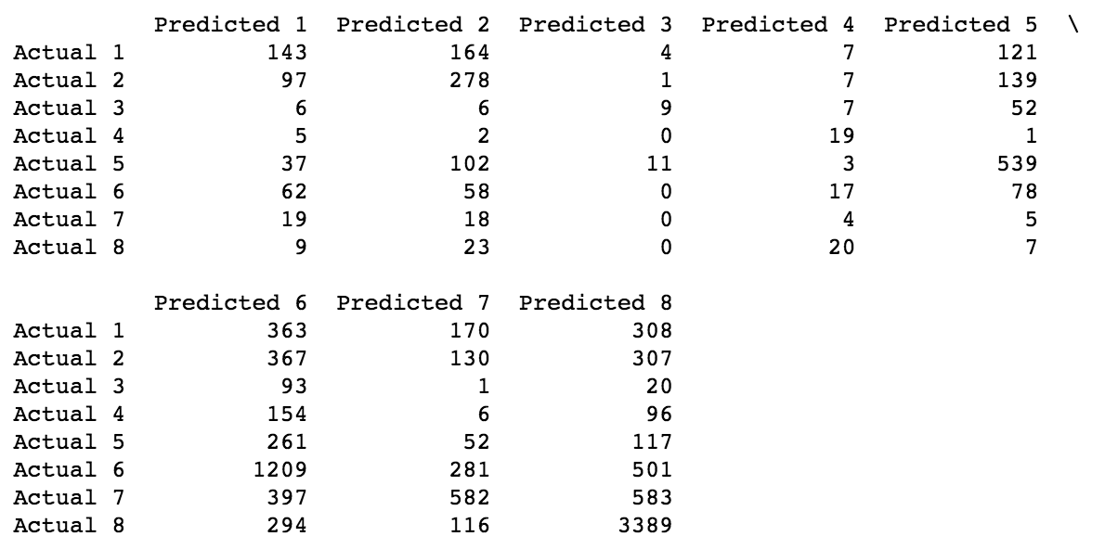
CONFUSION MATRIX of decision tree classifier

Slide 14
ACCURACY SCORE
Using Base Model Model Name | Train Accuracy (%) | Test Accuracy (%)
Logistic Regression | 49.2 | 47.9
Decision Tree | 100 | 40.3
Random Forest | 98.9 | 48.4
Using GridSearchCV Model Name | Train Accuracy (%) | Test Accuracy (%)
Decision Tree | 53.9 | 51.9
Random Forest | 48.4 | 48.6

Slide 15
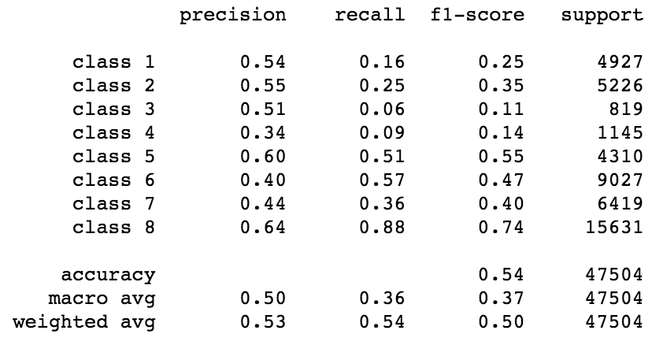
CLASSIFICATION REPORT of decision tree classifier

Slide 16
conclusion
We have compared the performance of the models using various model evaluation techniques.
Our objective is to precisely predict Response so that life insurance applications can be scrutinized easily, and correct decision be made.
Model evaluation step shows Decision Tree Classifier model is more suitable for this dataset.
After Decision tree, Random Forest Classifier also has very good accuracy score.
Advanced model techniques like xgBoost, neural network can be applied to further improve model accuracy.

